Slide 2
1
1.1 Go-Back-N
Sender
Receiver
1.2 Selective Repeat
Sender
Receiver
GBN / SR
FSM
2
2.1 TCP Tahoe
2.2 TCP Reno
TCP FSM

Slide 3
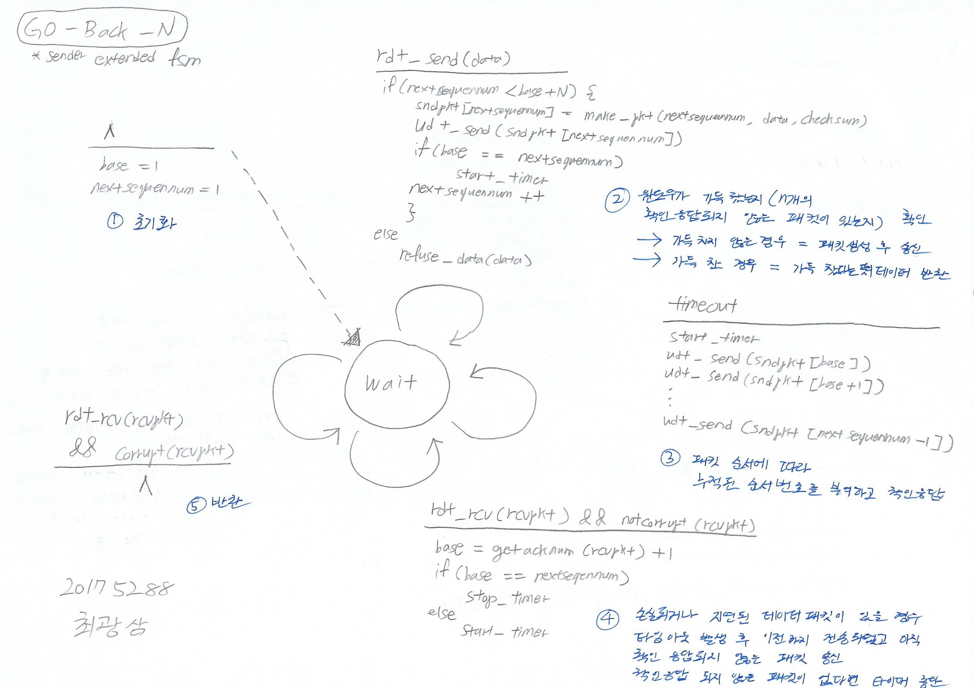
1.1
Go-Back-N
(Sender)

Slide 4
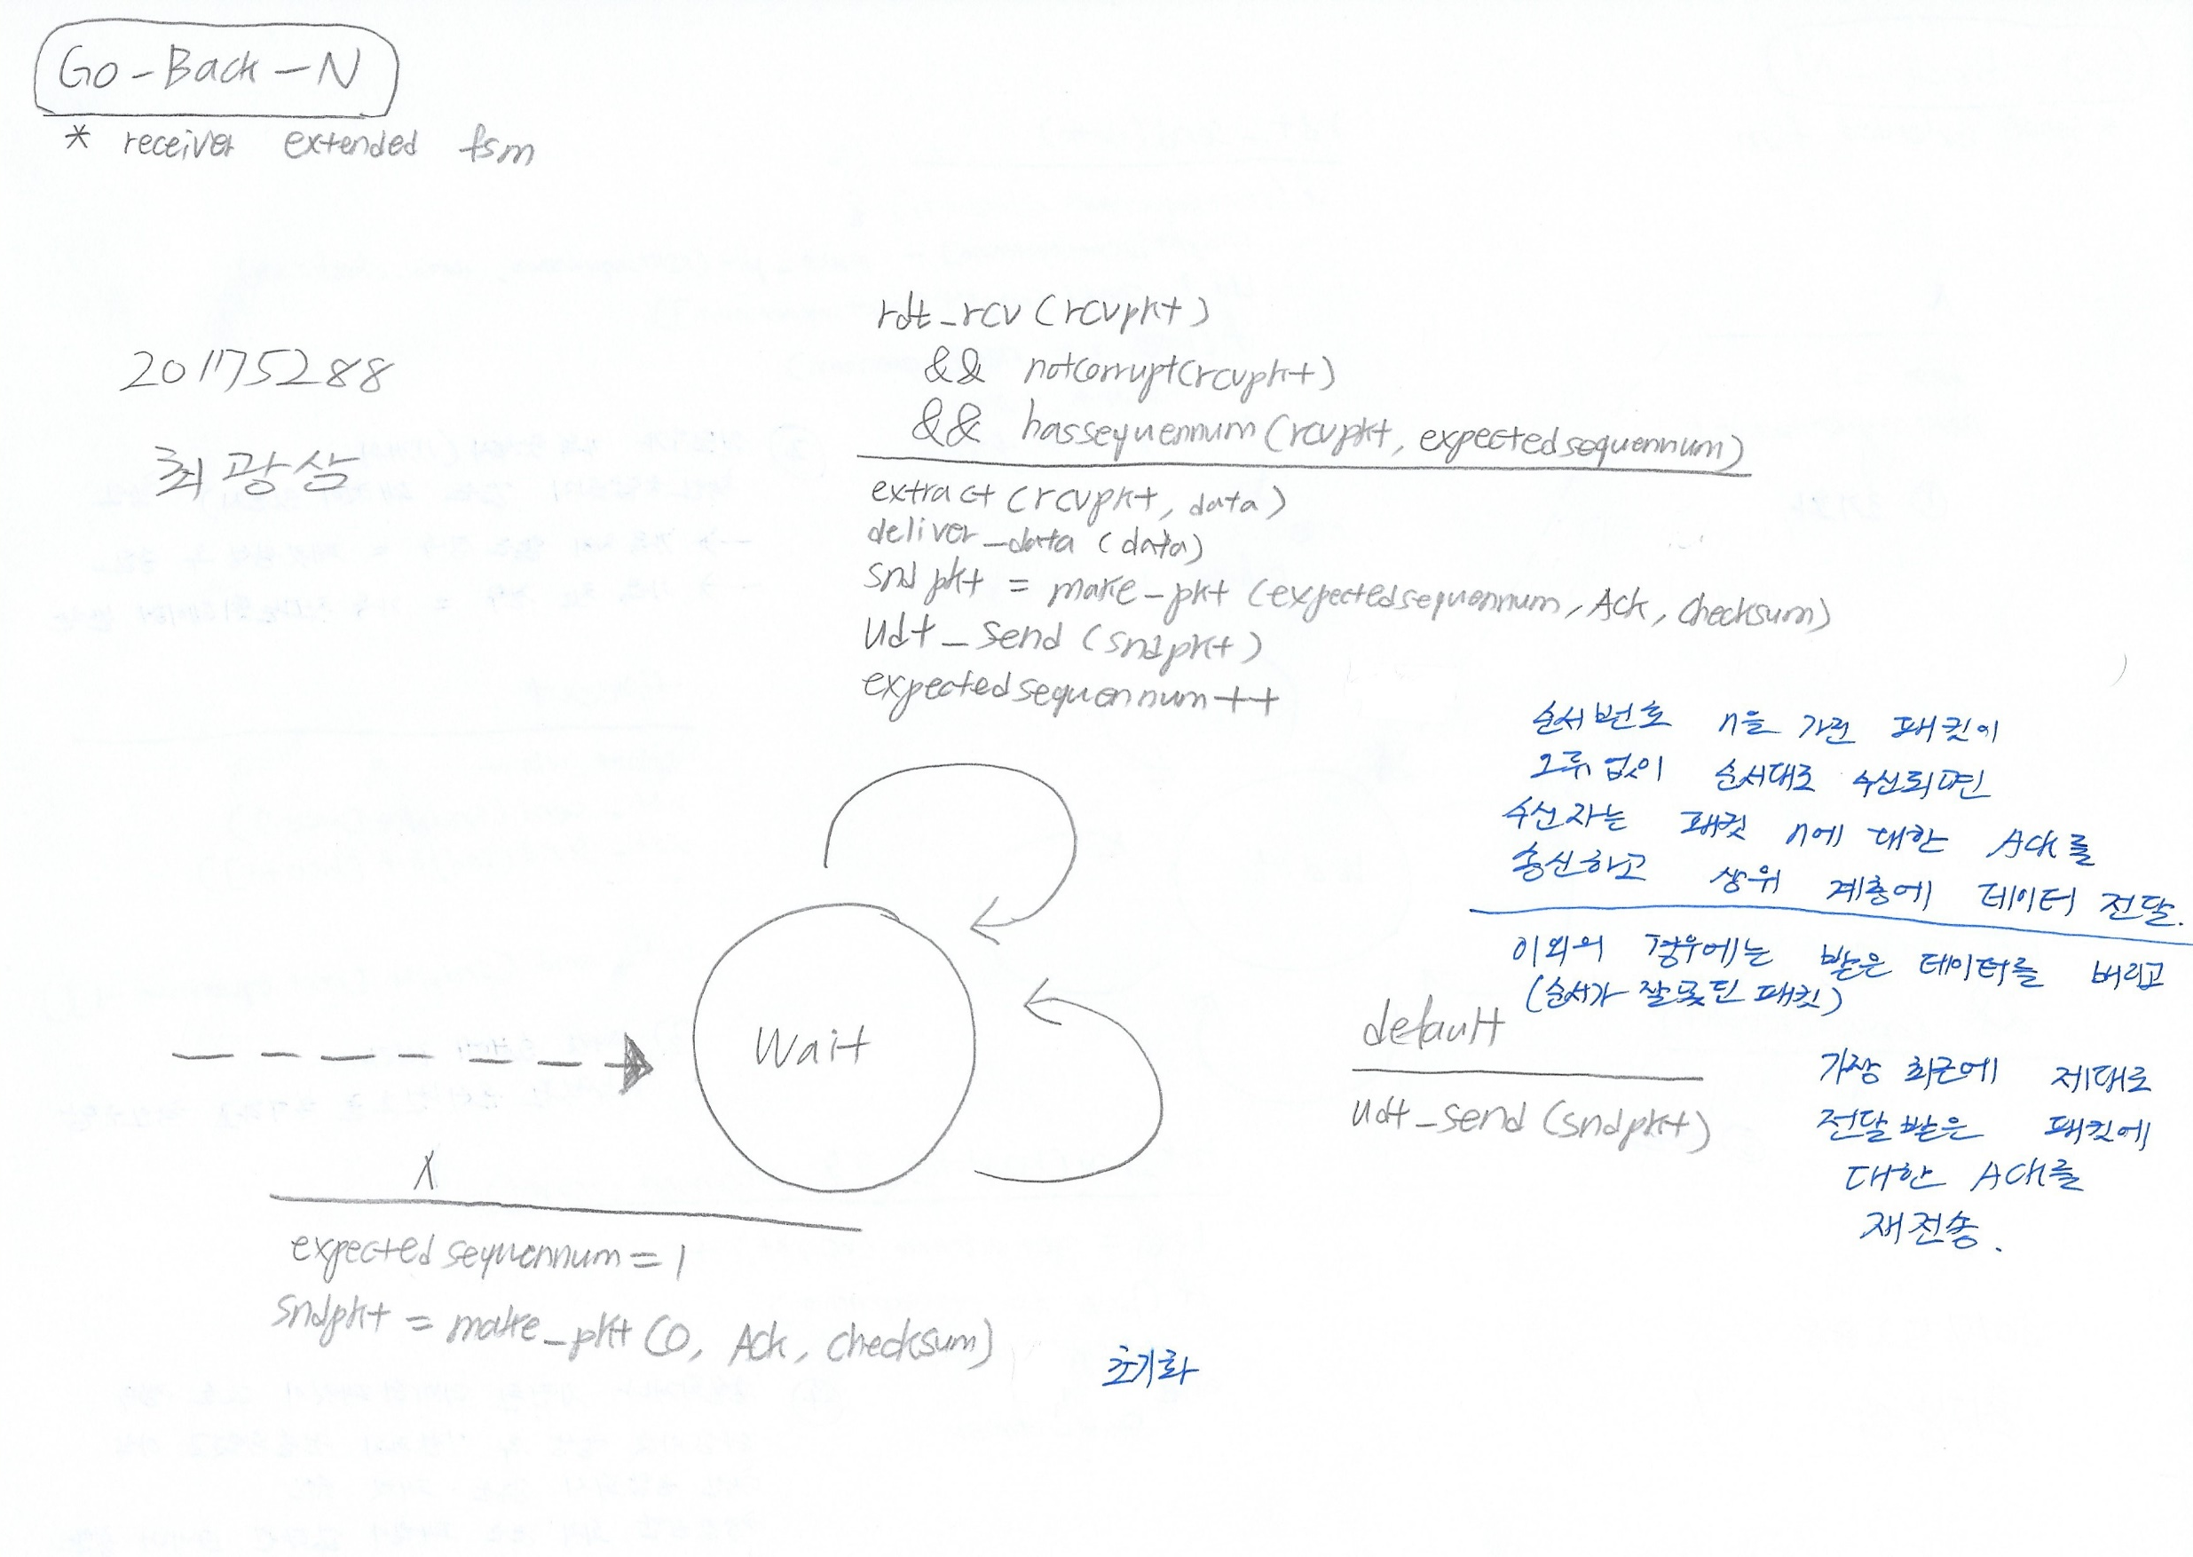
1.1
Go-Back-N
(Receiver)

Slide 5
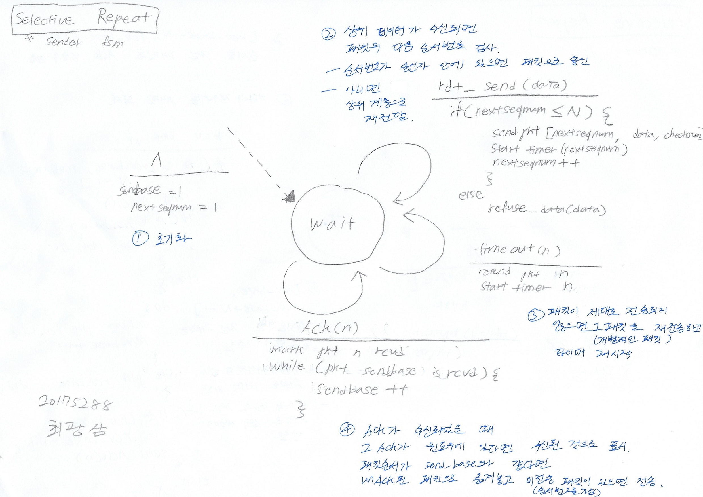
1.2
Selective Repeat
(Sender)

Slide 6
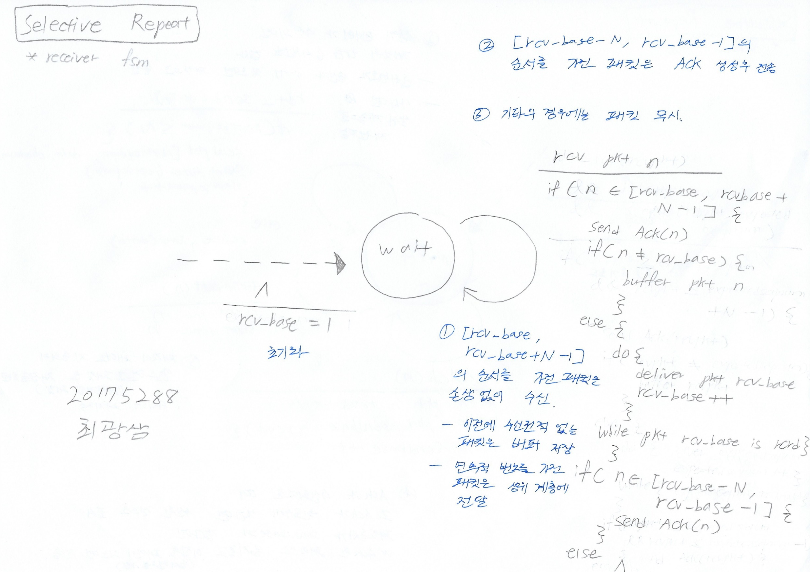
1.2
Selective Repeat
(Receiver)

Slide 7
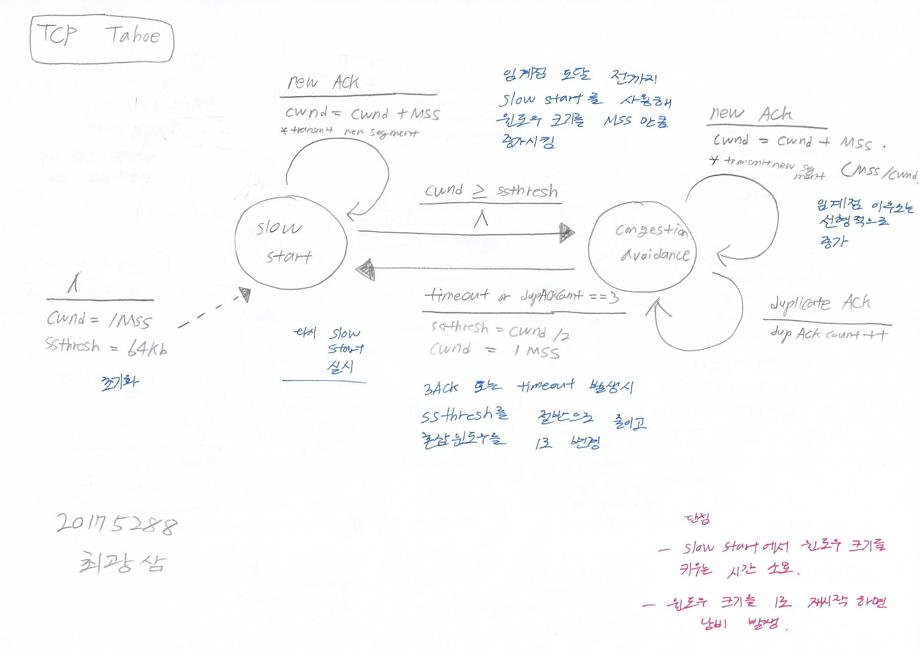
2.1
TCP Tahoe

Slide 8
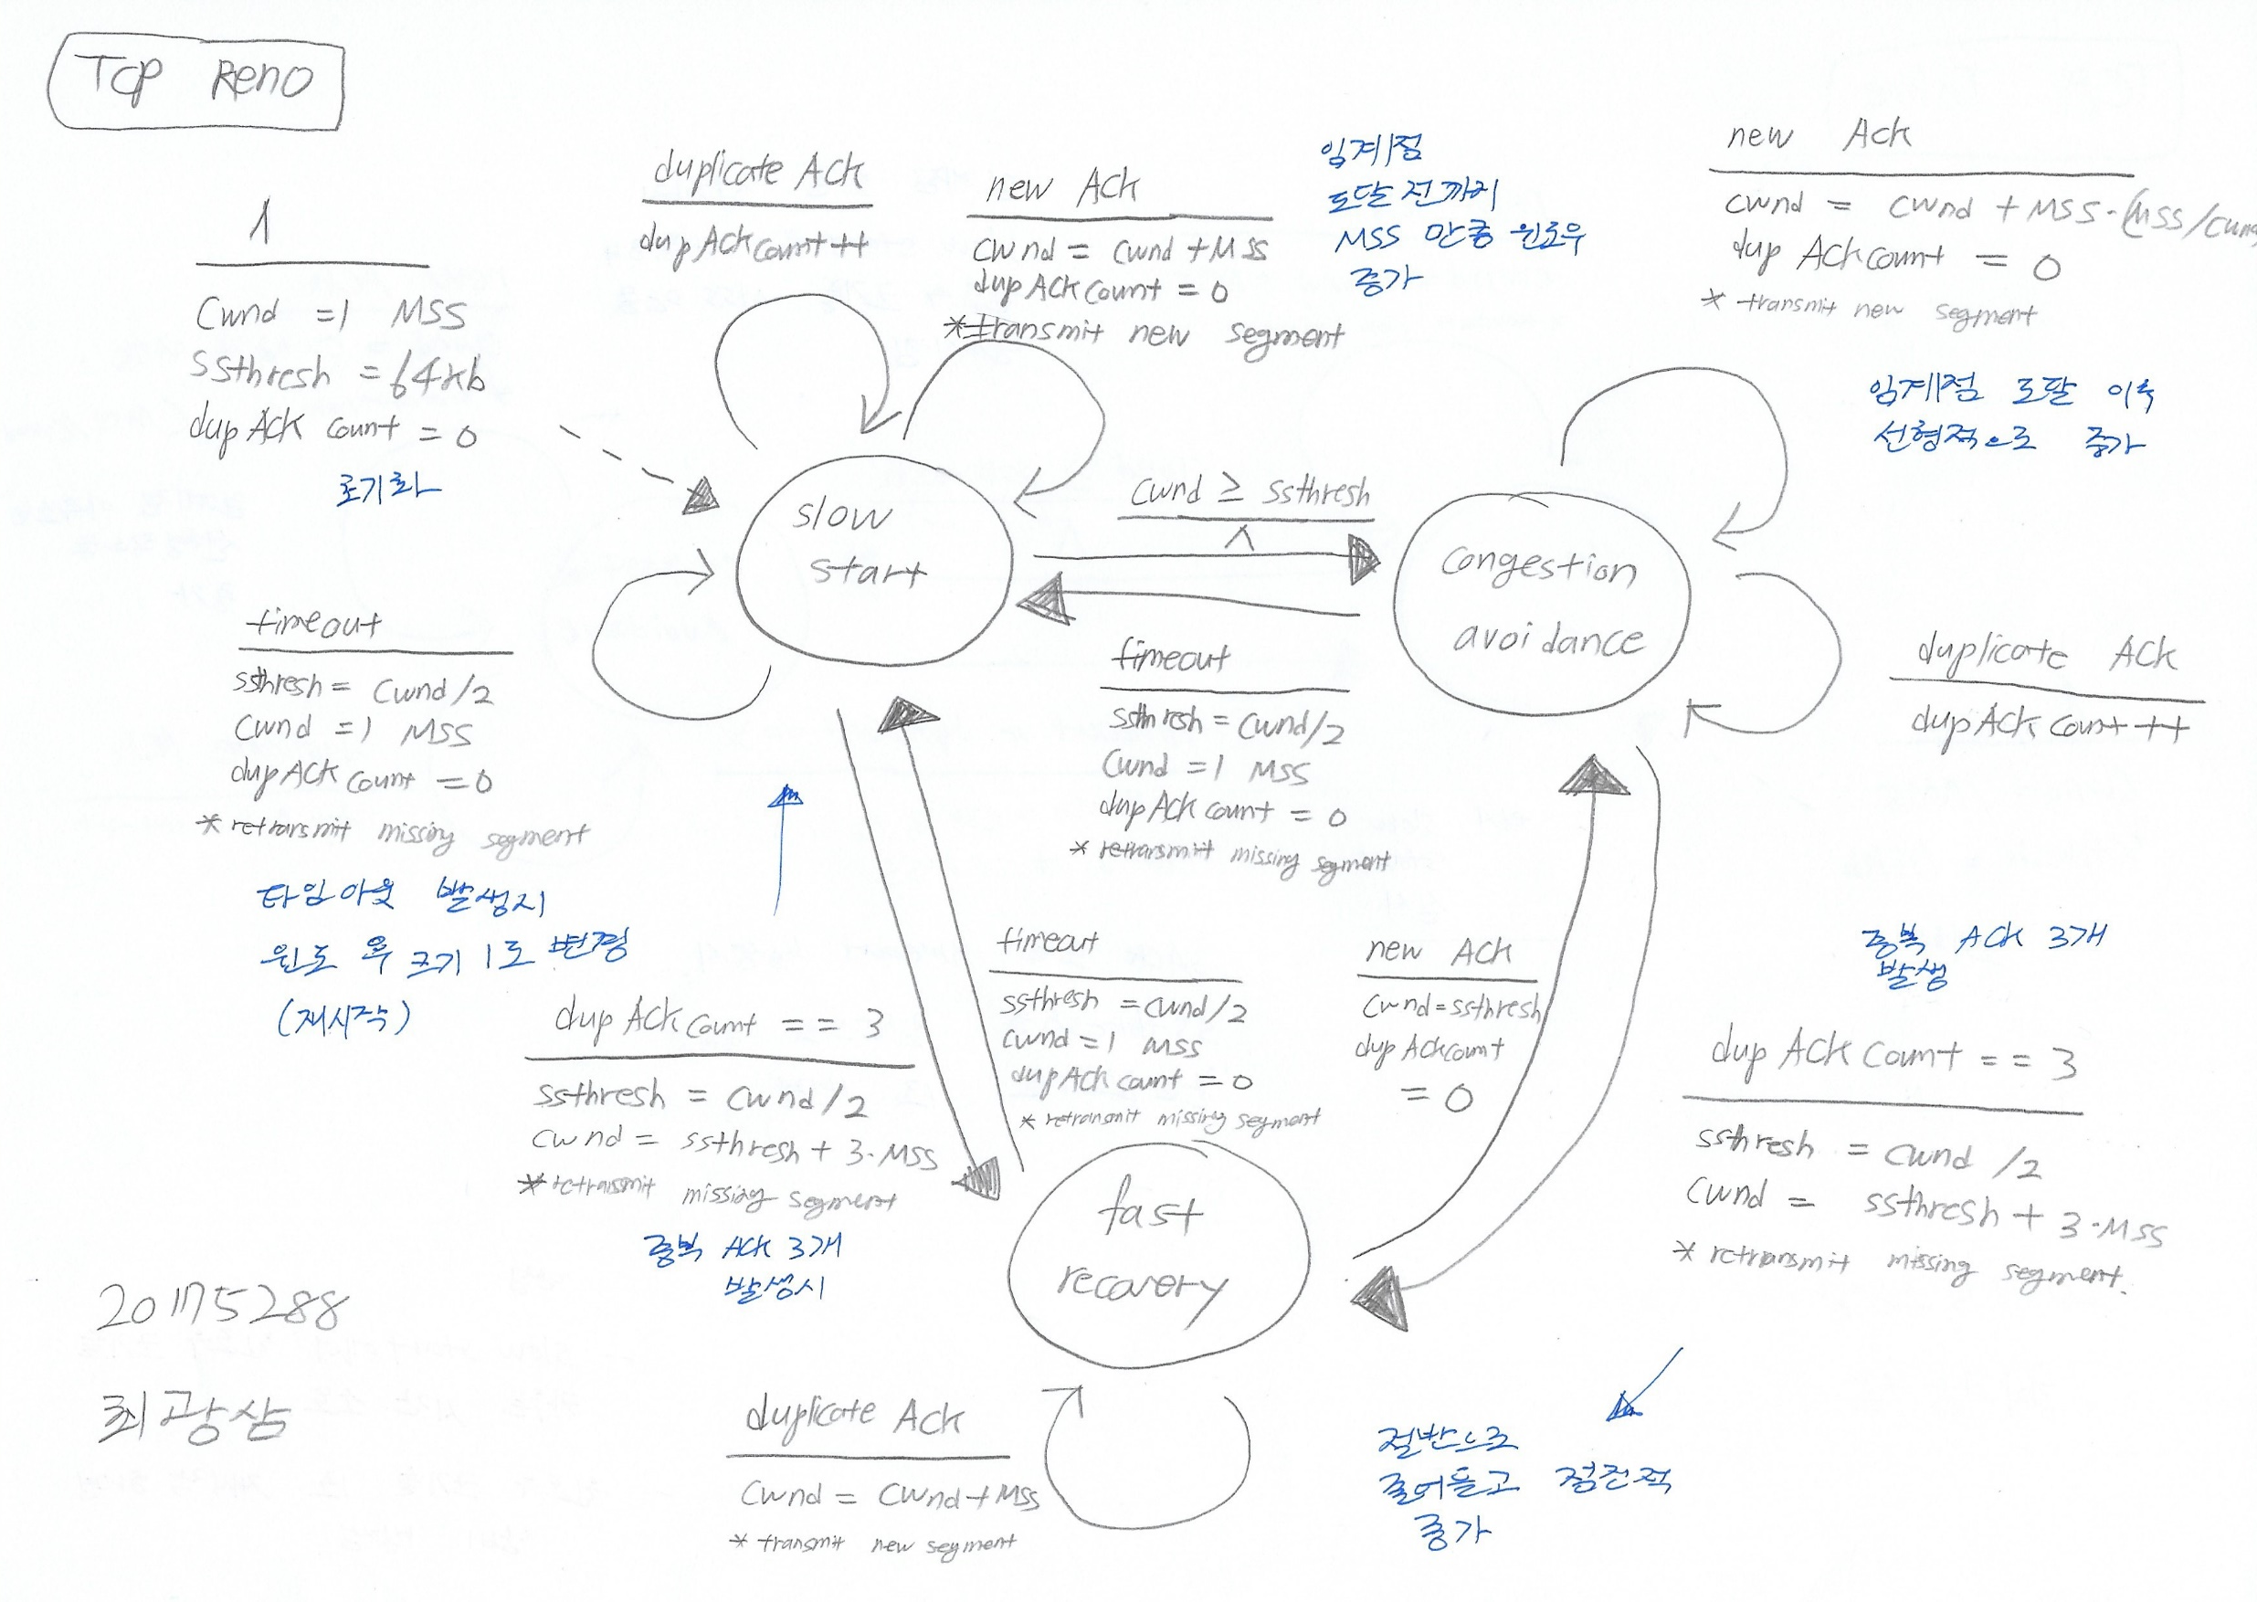
2.1
TCP Reno

